Slide 1

PRESENTING
MODERN
PROBLEM
MODERN
SOLUTION

Slide 2
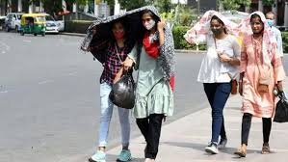
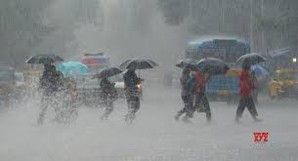
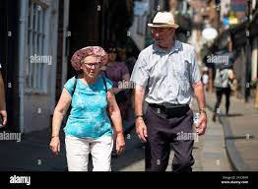
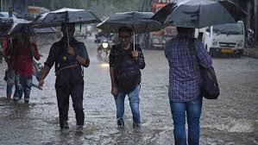
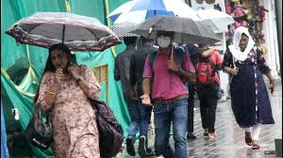
THE PROBLEM
PROBLEM WE FACE IN RAIN/SUMMER
When we have to carry luggage or bag in heavy rain
Caps only cover head what about body?
Hand gets tired holding on umbrella
Hand fan will help a little
Rain
Hot weather
Busy hand

Slide 3
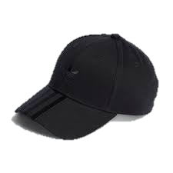
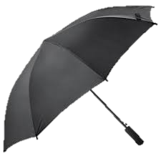
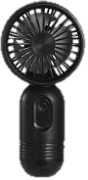
THE SOLUTION
?
WHAT? HOW? WHY?

Slide 4
THE SOLUTION
?
UMBRELLA?+CAP?+ HAND FAN? =?

Slide 5
UMBRELLA
WE USE UMBRELLA FOR MANY PURPOSE
IN SUMMER ,TO PROTECT FROM SUNLIGHT
IN WINTER ,TO PROTECT FROM SNOWFALL
IN RAINY SEASON, TO PROTECT FROM RAIN

Slide 6
CAP
WHY WE WEAR CAPS
PROTECT OUR HEAD FROM SUN RAISE

Slide 7
HAND FAN
WHY WE USED HAND FAN
EASY TO CARRY
EASILY AVAILABLE

Slide 8
A MIXTURE
WHAT IF THESE THREE THINGS GET COMBINED THEN
WILL IT BE HECTIC OR HELPFUL?
WILL WORK OUT OR GET FLOPPED?
EXPENSIVE OR CHEAP?

Slide 9
FINAL RESULT
AN UMBRELLA CAP WITH A FAN AND A SMALL SOLAR PANEL ON IT
HELP IN CARRY YOUR LAGUAGE
EASILY COVER HEAD AND BODY
NEED CHILLED AIR TURN ON THE FAN
NO NEED OF HAND TO HOLD IT

